Slide 1
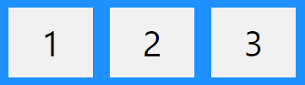
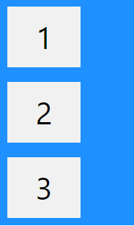

C3-S5-Flex Box-Summary
Flex-container=Parents
The flex container properties are:
Flex-direction
Row
Column

Slide 2



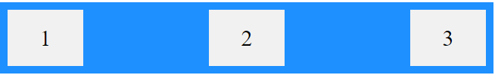


Justify-content
Center
Space-around
Flex-start
Space-between
Flex-end
Space-evenly

Slide 3

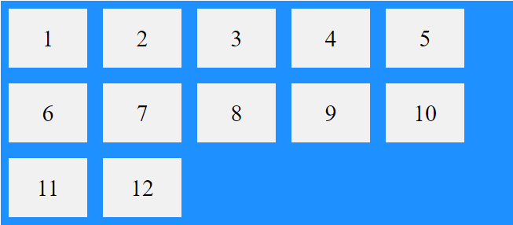
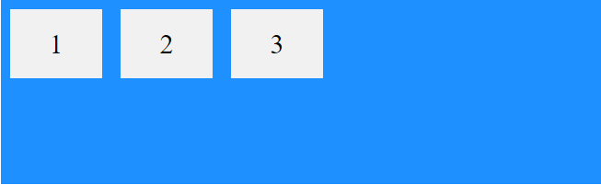

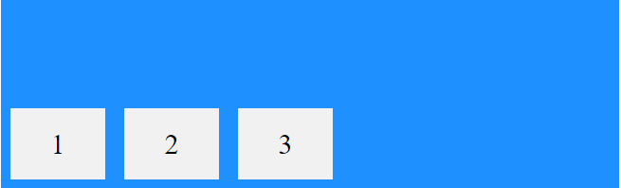
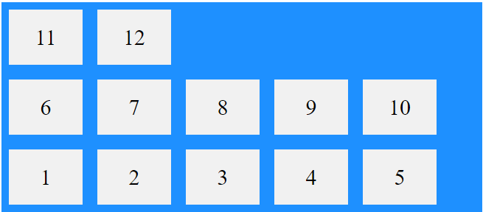
Align-items
Flex-wrap
Center
Wrap
Flex-start
Nowrap
Wrap-reverse
Flex-end

